Slide 1

WELCOME

Slide 2
EXPLORATORY ANALYSIS ON VIDEO GAME SALES IN THE MARKET
MOHAMED NOUFAL PM

Slide 3
INTRODUCTION
It was in the 60’s the video games introduced to the market. In 70’s the first home video game console came in. It took more than one decade to hold its share in the market. The invention of handheld game console in the early 90’s played its role enough to gain its first major share in the market. By the end of 90’s the entry of internet made a revolution in video game sales just like in many other. Then comes the smartphones. It affected the video game console sales in a negative way.
In this analysis we are going to study growth of video game sales in different markets based on different attributes. So lets begin….

Slide 4
Genres in video games
Sports | Platform
Racing | Role-Playing
Puzzle | Misc
Shooter | Simulation
Action | Fighting
Adventure | Strategy

Slide 5
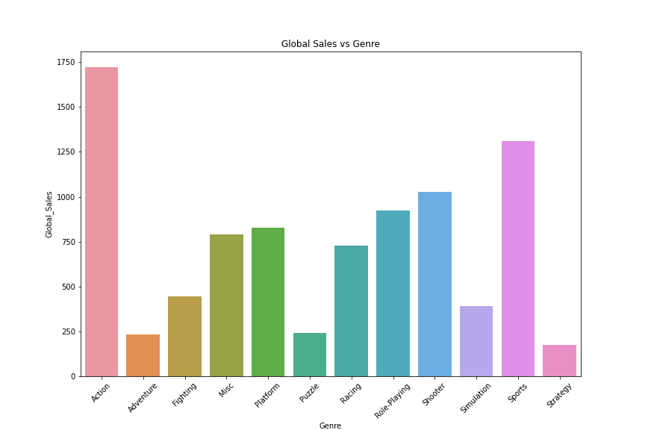

Slide 6
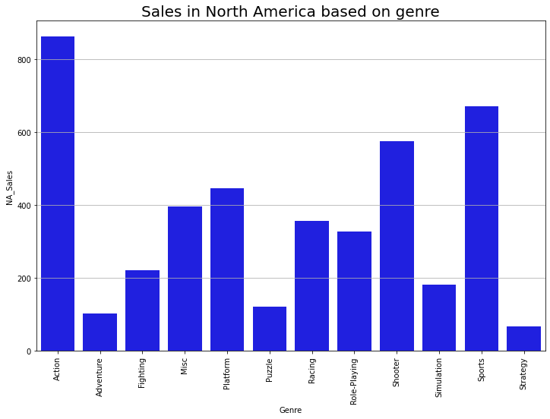
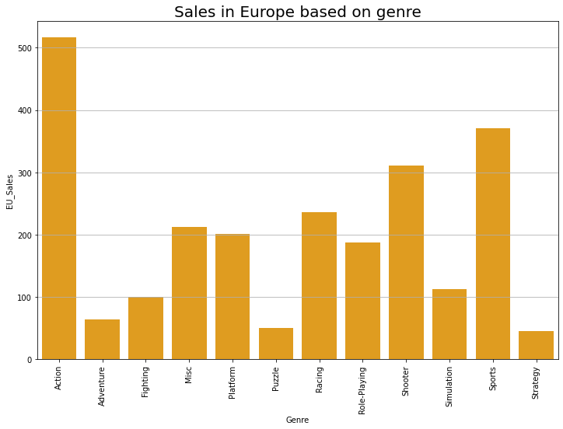
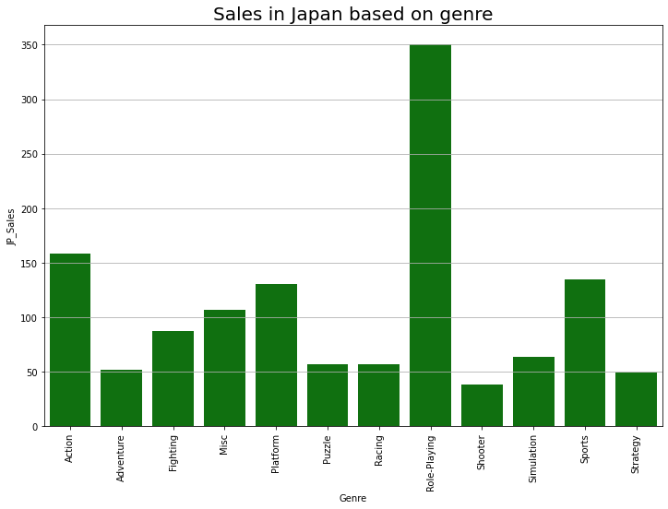
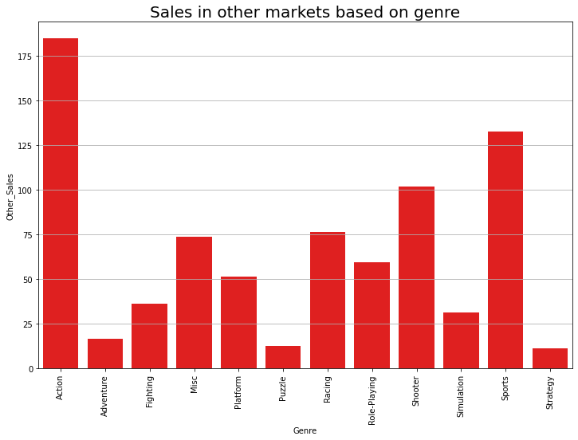

Slide 7
PLATFORMS FOR VIDEO GAMES
These are some of many platforms in the world for video game.
XOne, X360, PS3, PS2, PSP, PS4, Wii, DC, NES, GB, DS, SNES, GBA, 3DS, N64,PS, XB, PC, 2600, GC, WiiU, GEN, PSV, SAT,SCD, WS, NG, TG16, 3DO, GG, PCFX.

Slide 8
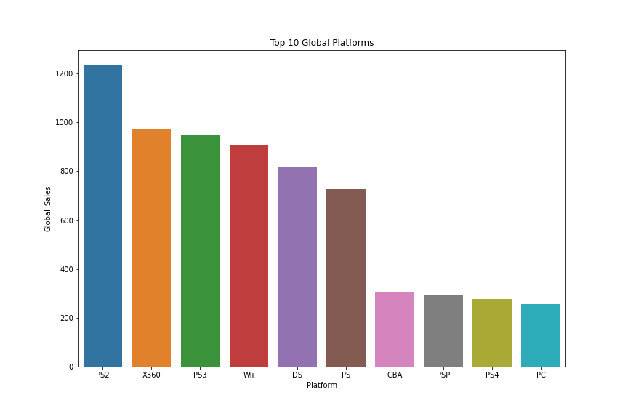

Slide 9
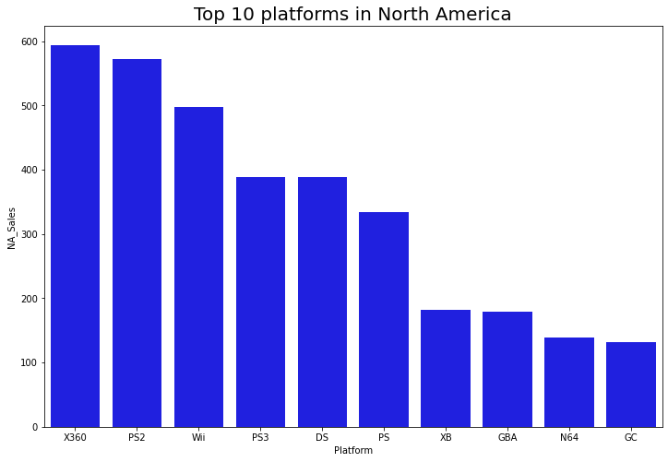
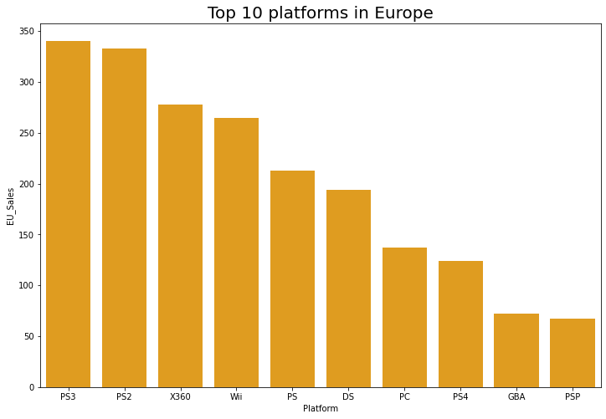
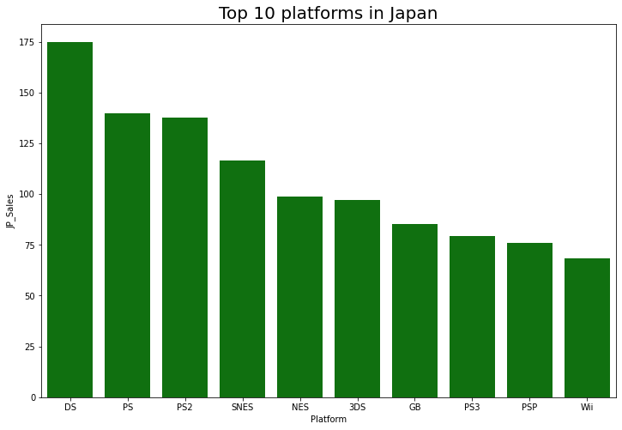
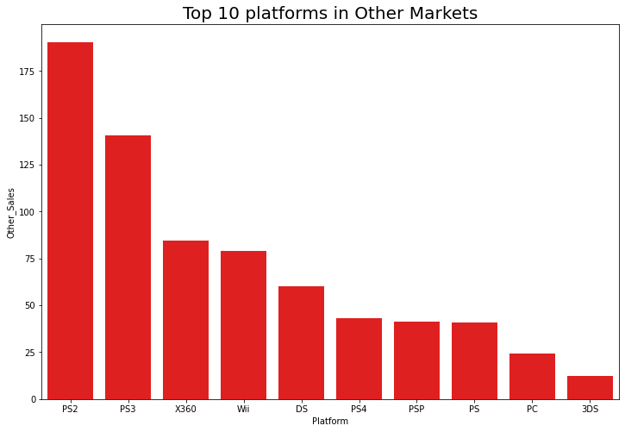

Slide 10
TOP PUBLISHERS

Slide 11
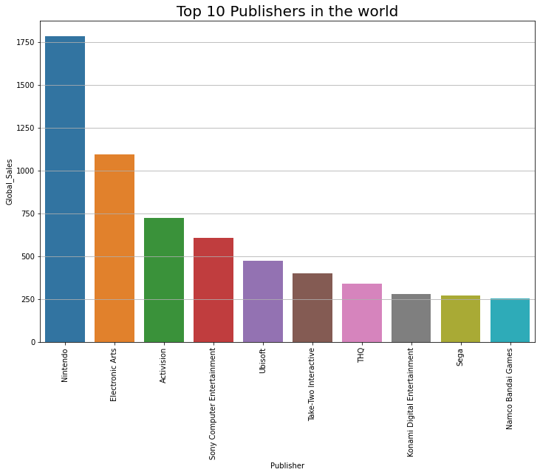

Slide 12

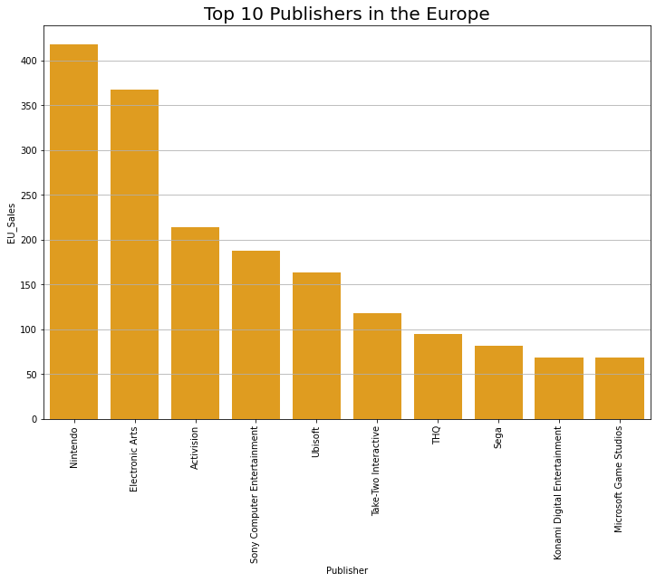
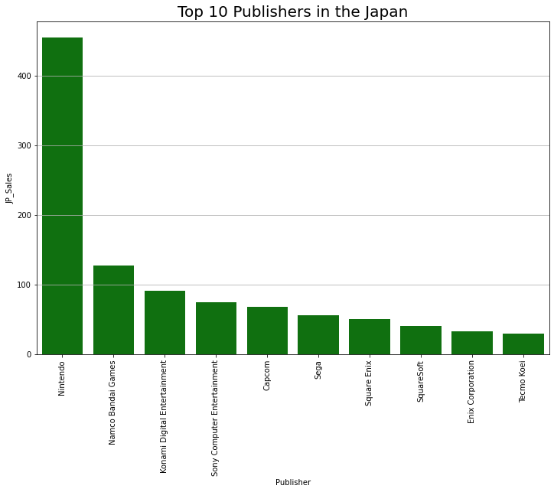
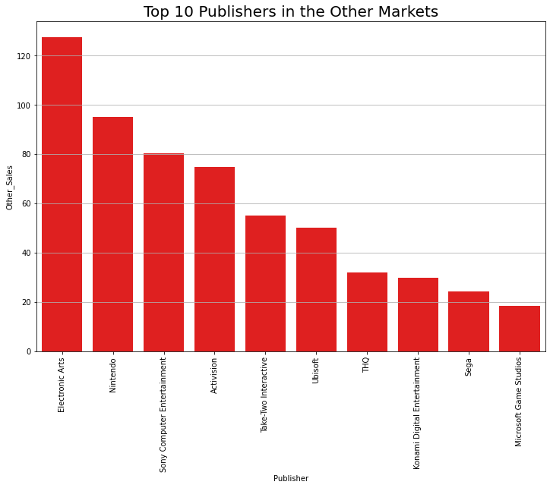

Slide 13
TOP GAMES

Slide 14
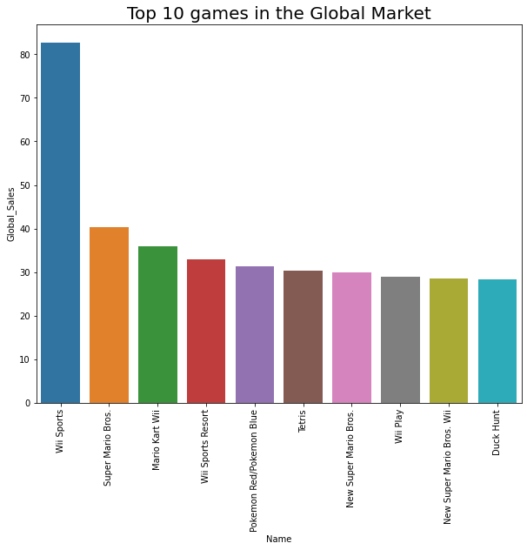

Slide 15
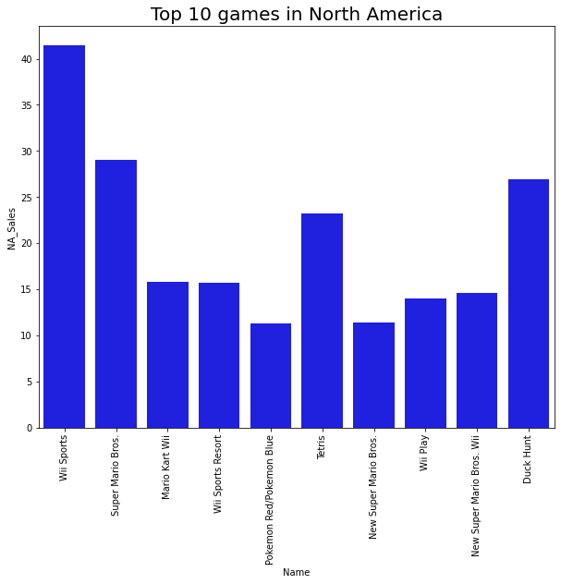
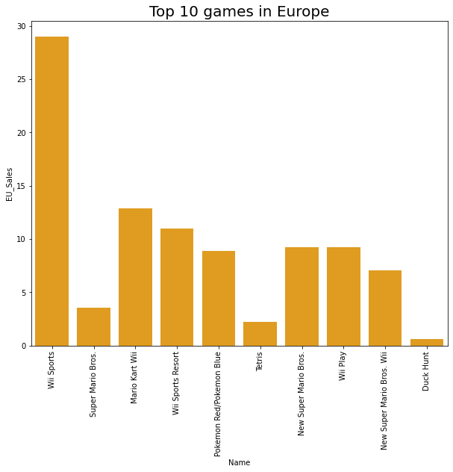
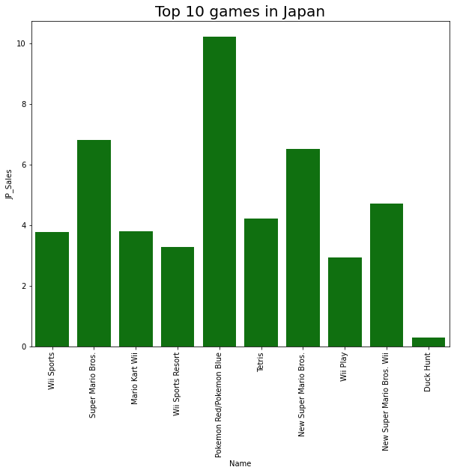
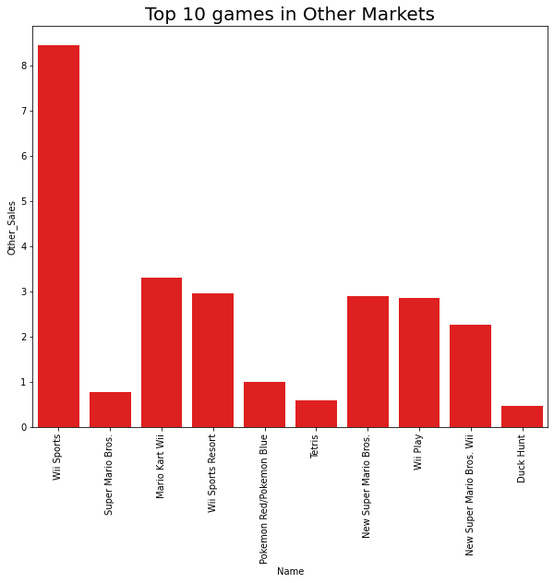

Slide 16
SALES OVER THE YEARS

Slide 17
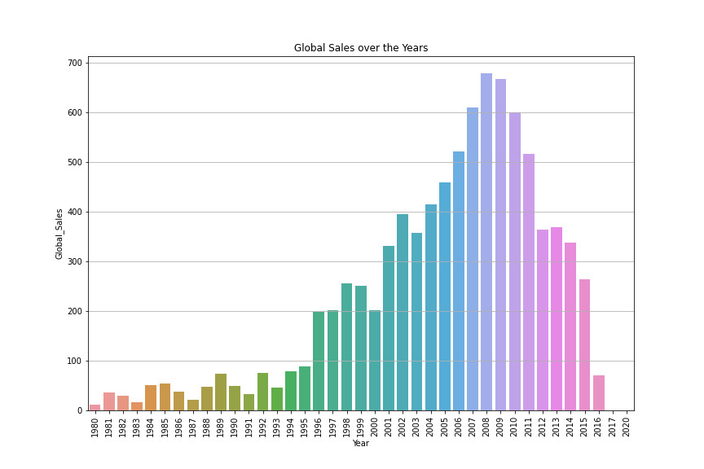

Slide 18
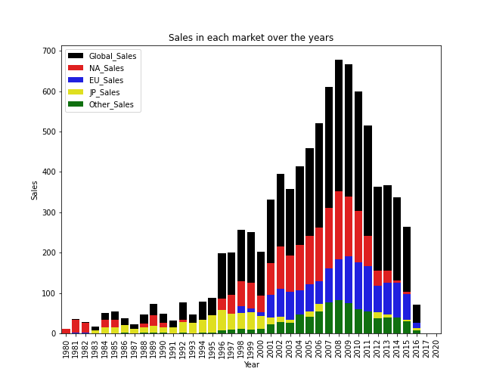

Slide 19
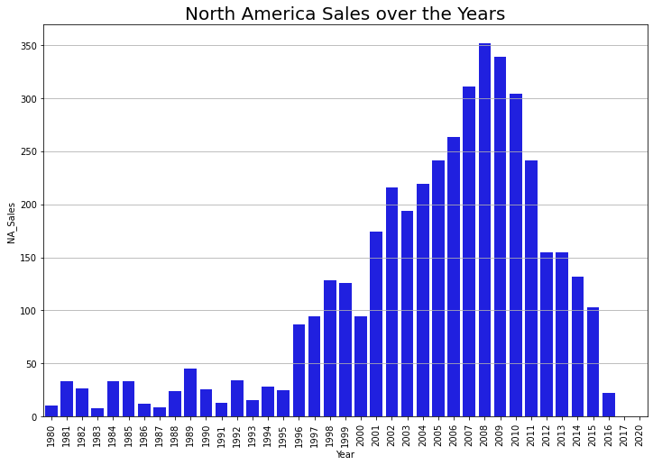
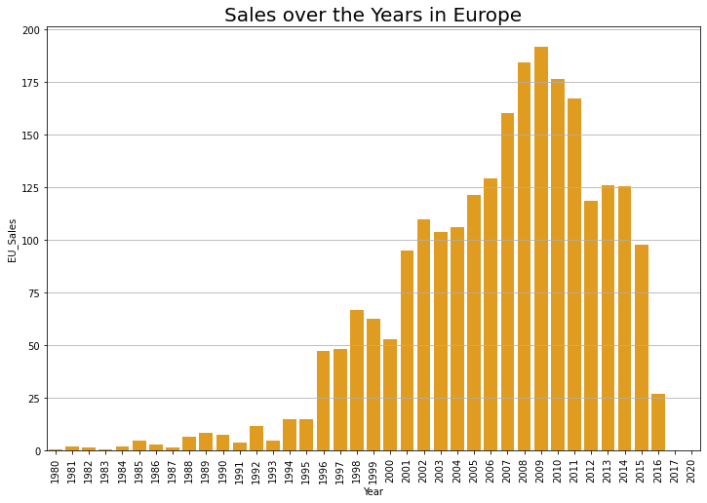
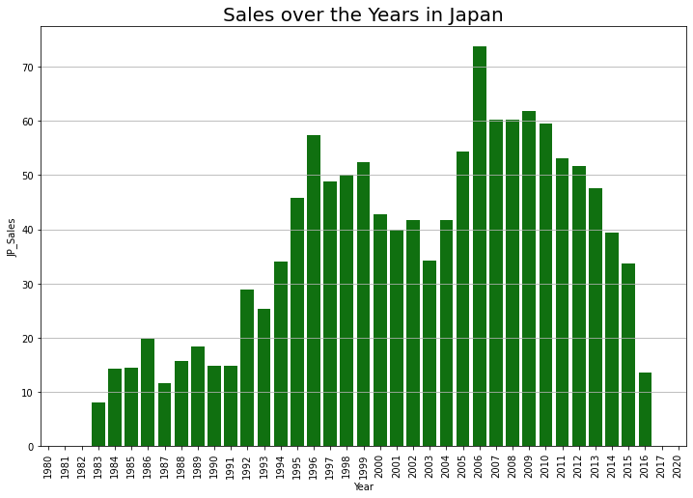
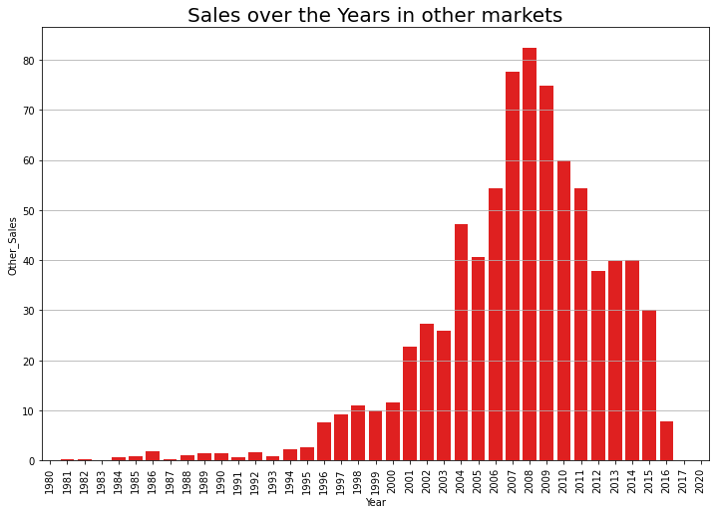

Slide 20
LAST DECADE SALES

Slide 21
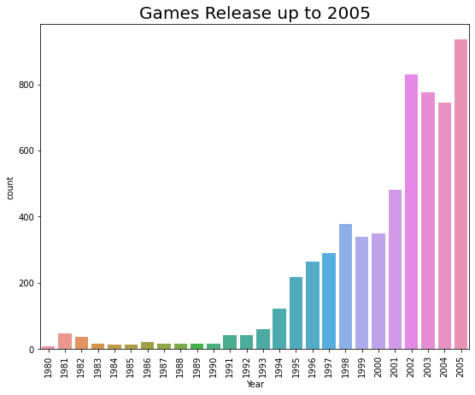
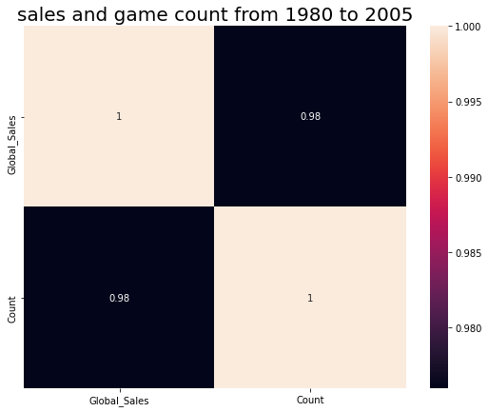
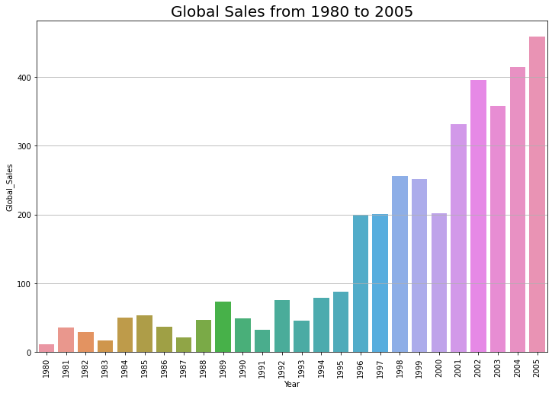

Slide 22
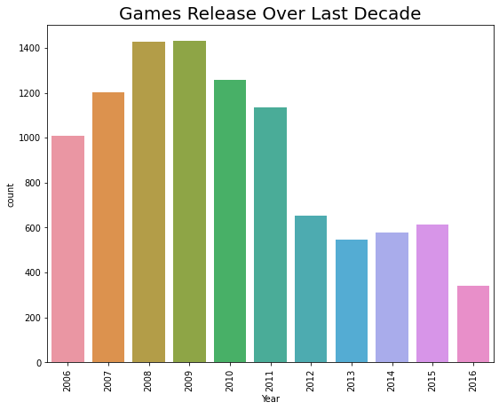

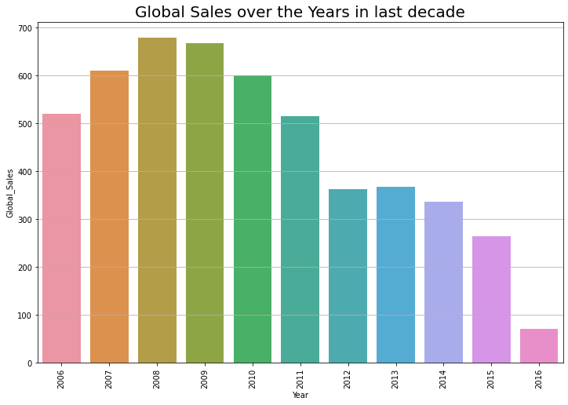

Slide 23
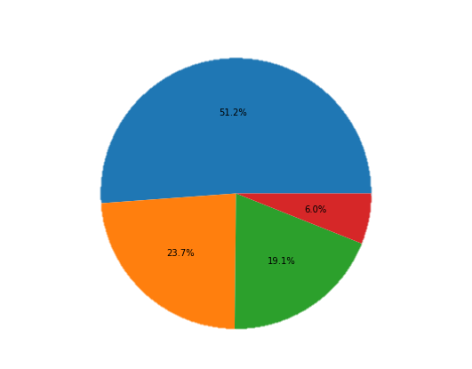
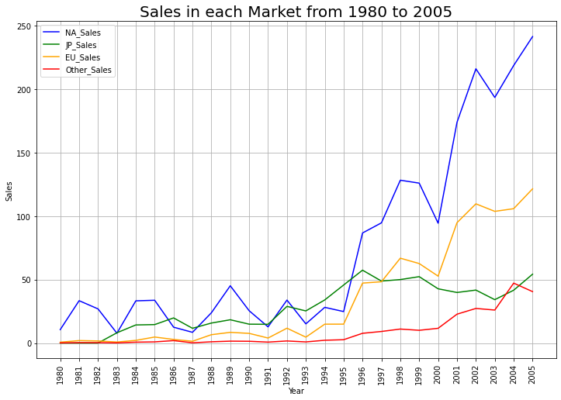

Slide 24
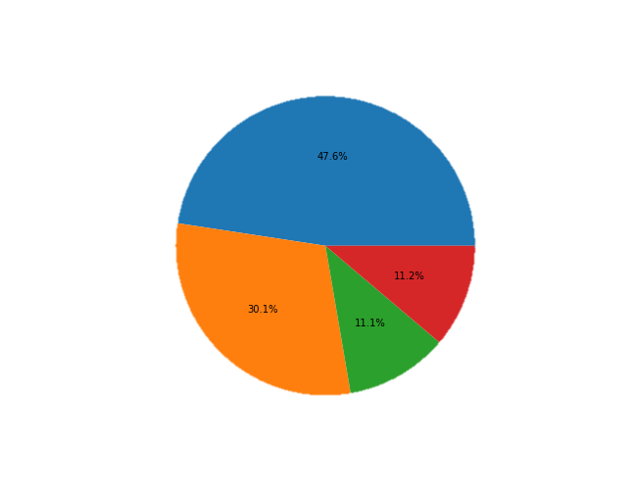
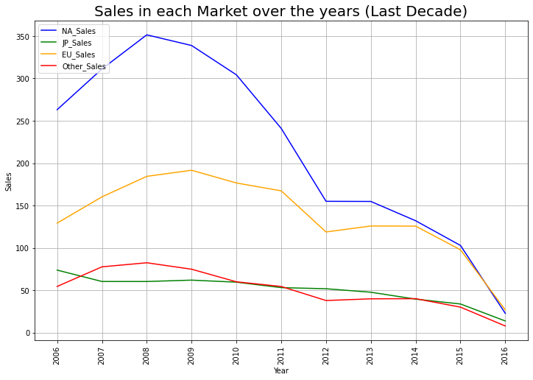

Slide 25
THANK YOU

